Slide 1



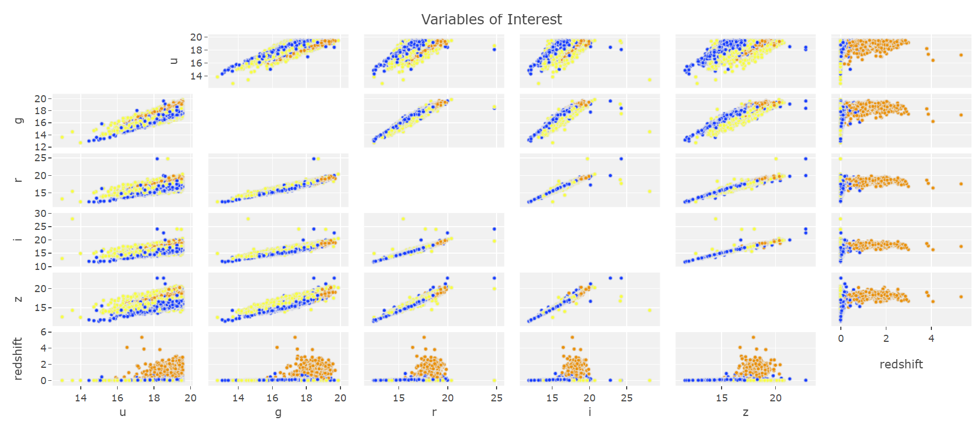
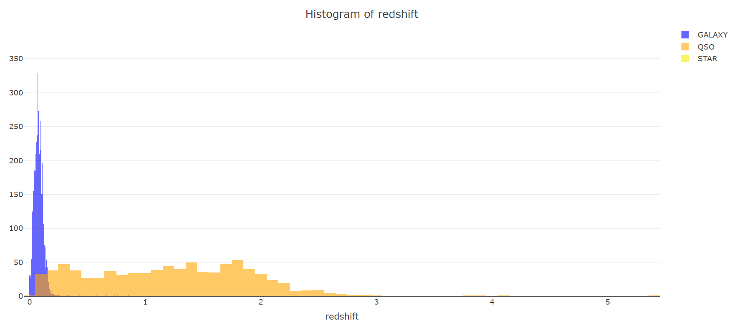
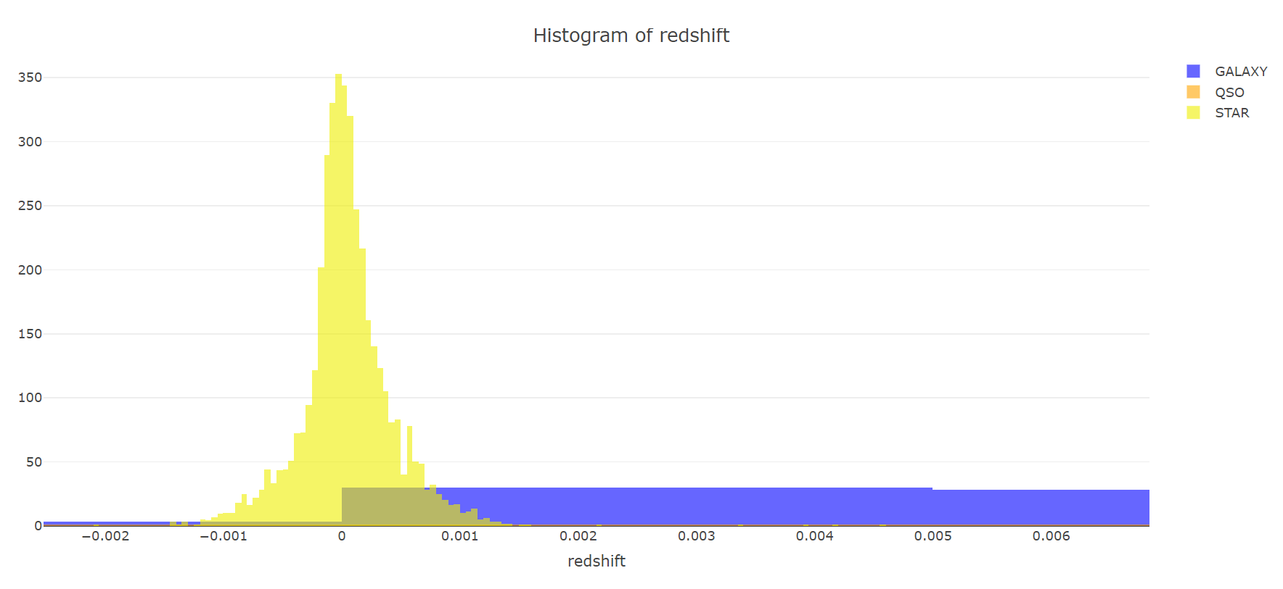
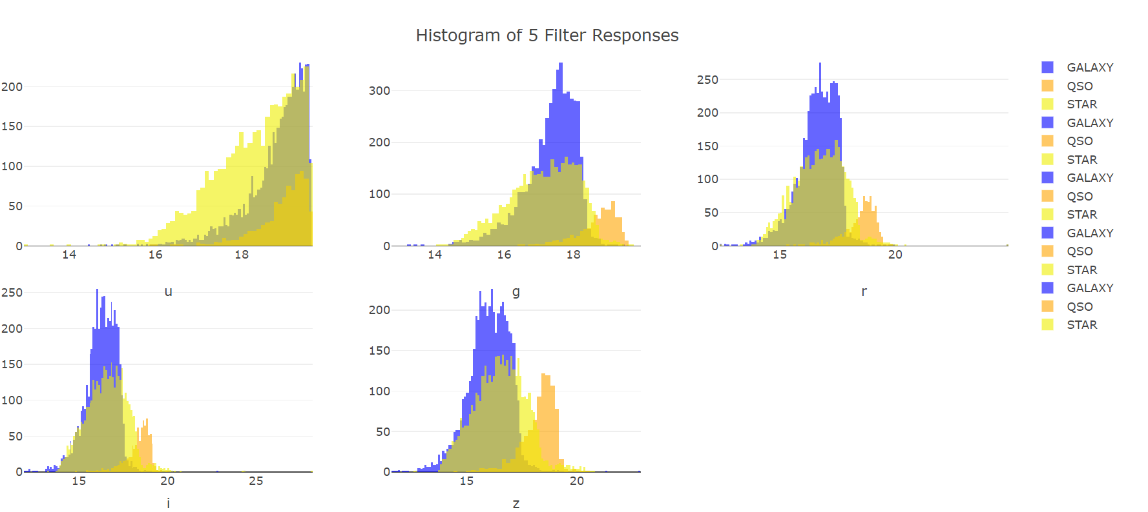
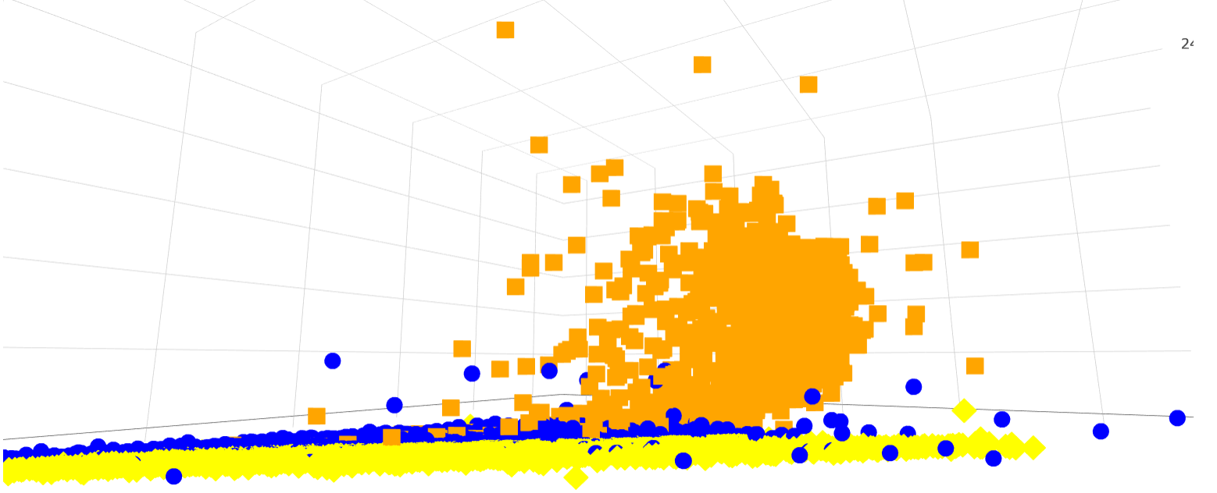
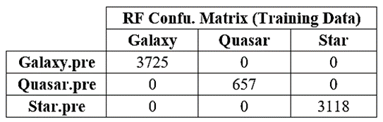
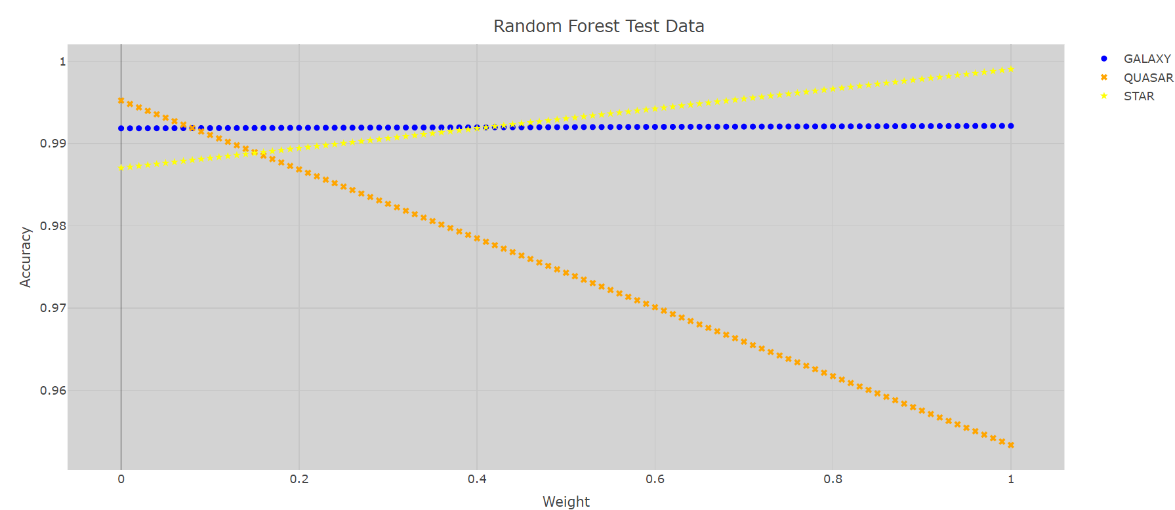
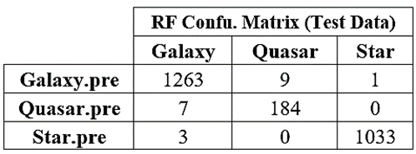
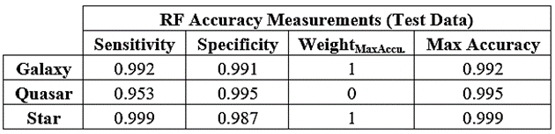
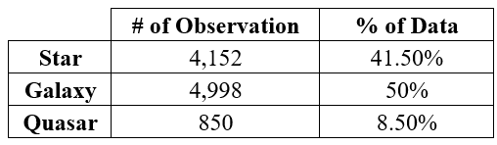
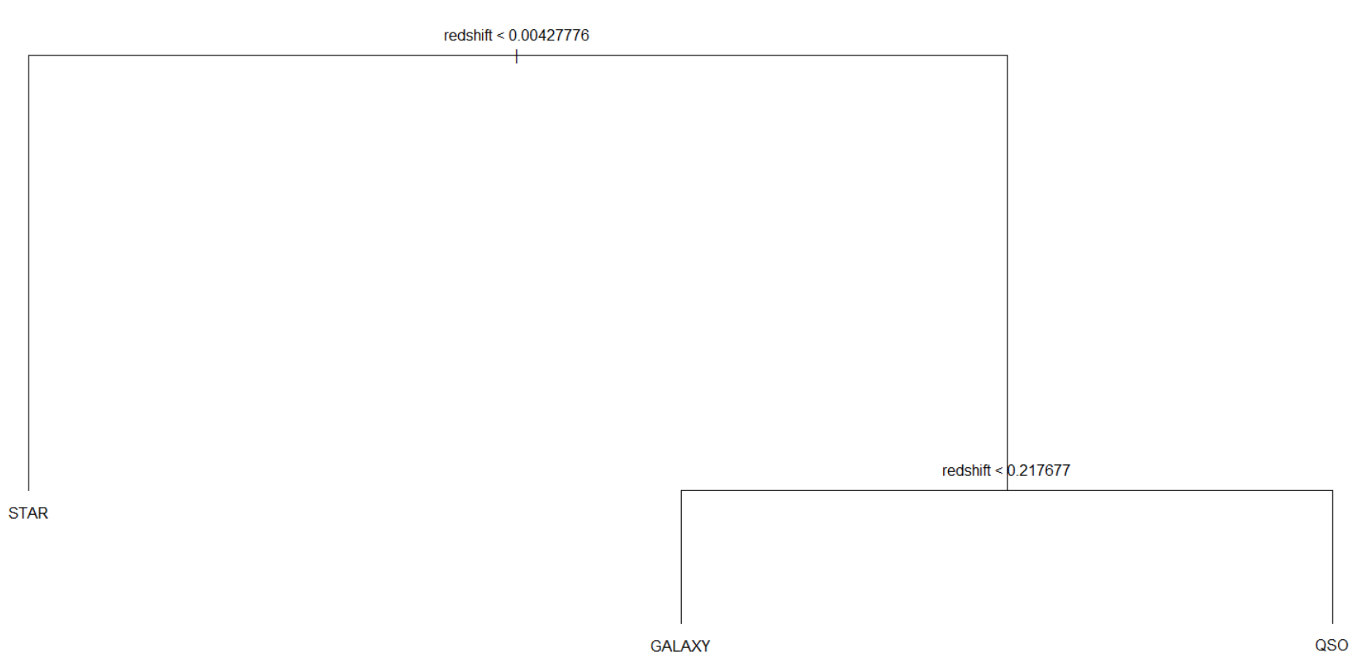
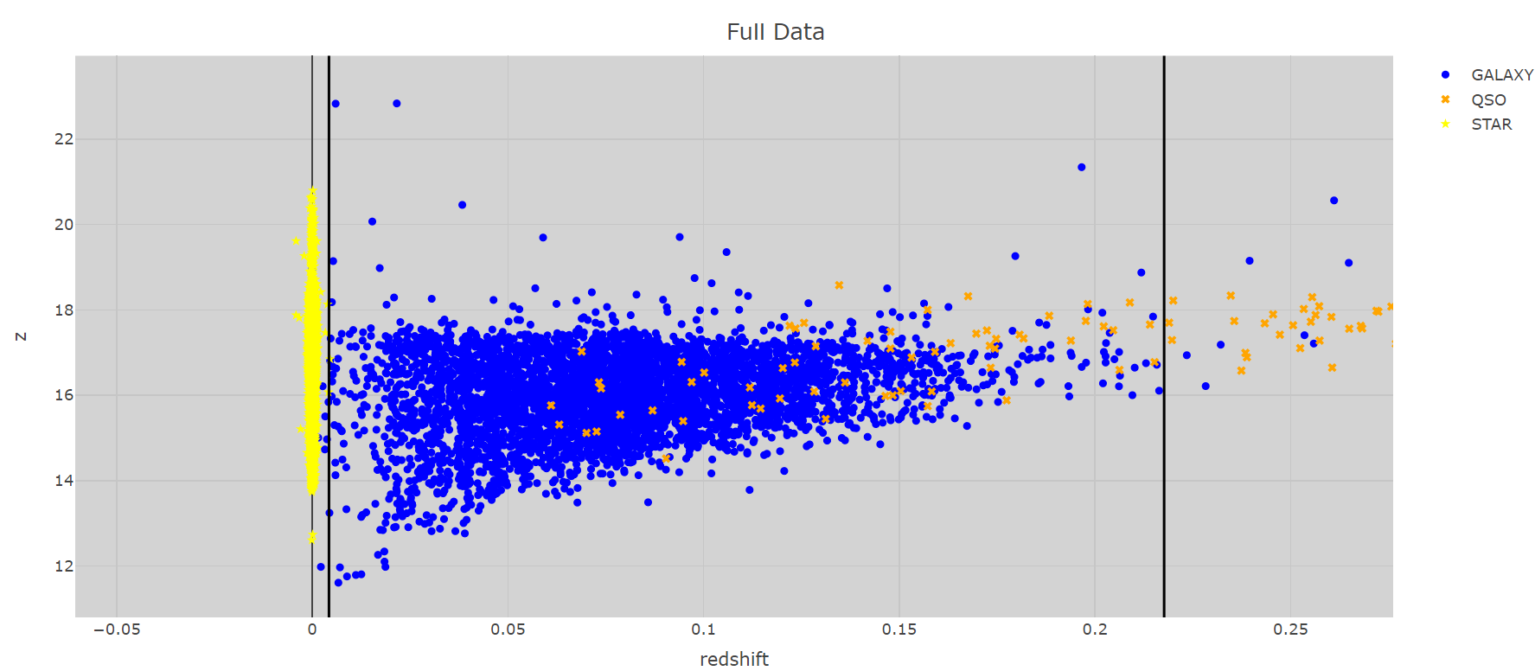


Sloan Digital Sky Survey Analysis
Ian Scarff
STAT 485
What is SDSS
Exploratory Analysis
Goal
The SDSS purpose is to do large scale surveys of the night sky and create detailed three-dimensional maps of the universe.
Based at Apache Point Observatory in New Mexico.
Identify the best model for classifying objects as stars, galaxies, or quasars.
Methods & Procedures
Purpose of Project
Training Dataset: Random sample, 75% of data.
Test Dataset: Remaining 25%.
Predictor Variables:
u, g, r, i, z
Redshift
Response Variable:
Class
Models:
Linear Discriminant Analysis
Quadratic Discriminant Analysis
Basic Trees
Random Forest
$$Accuracy_{class}=\left(w×sensitivity\right)+(\left(1−w\right)×specificity)$$
w: a tuning parameter, ranging from 0 to 1, with 0.01 increments.
Develop a model to help astronomers classify objects quickly and accurately.
Aid in astronomical research.
Data
SDSS’s data dump 14 found on the website Kaggle.
10,000 observations, each with 18 variables.
Results
Variables of Interest
Random Forest
u, g, r, i, z
Responses from the five optical filters using the Thuan-Gunn Star Magnitude System.
Redshift
Ratio between the observed wavelength and rest wavelength minus 1
$redshift=\frac{λ_{observed}}{λ_{rest}}−1$
Class
Type of object: Star, Galaxy, Quasar.
Conclusions
Random Forest had the highest class accuracies.
Over all optimal accuracy lies around a weight of w = 0.15.
Redshift identified as the most important variable. (according to the Gini Index) (Makes sense astronomically)
Basic Tree

